Slide 1
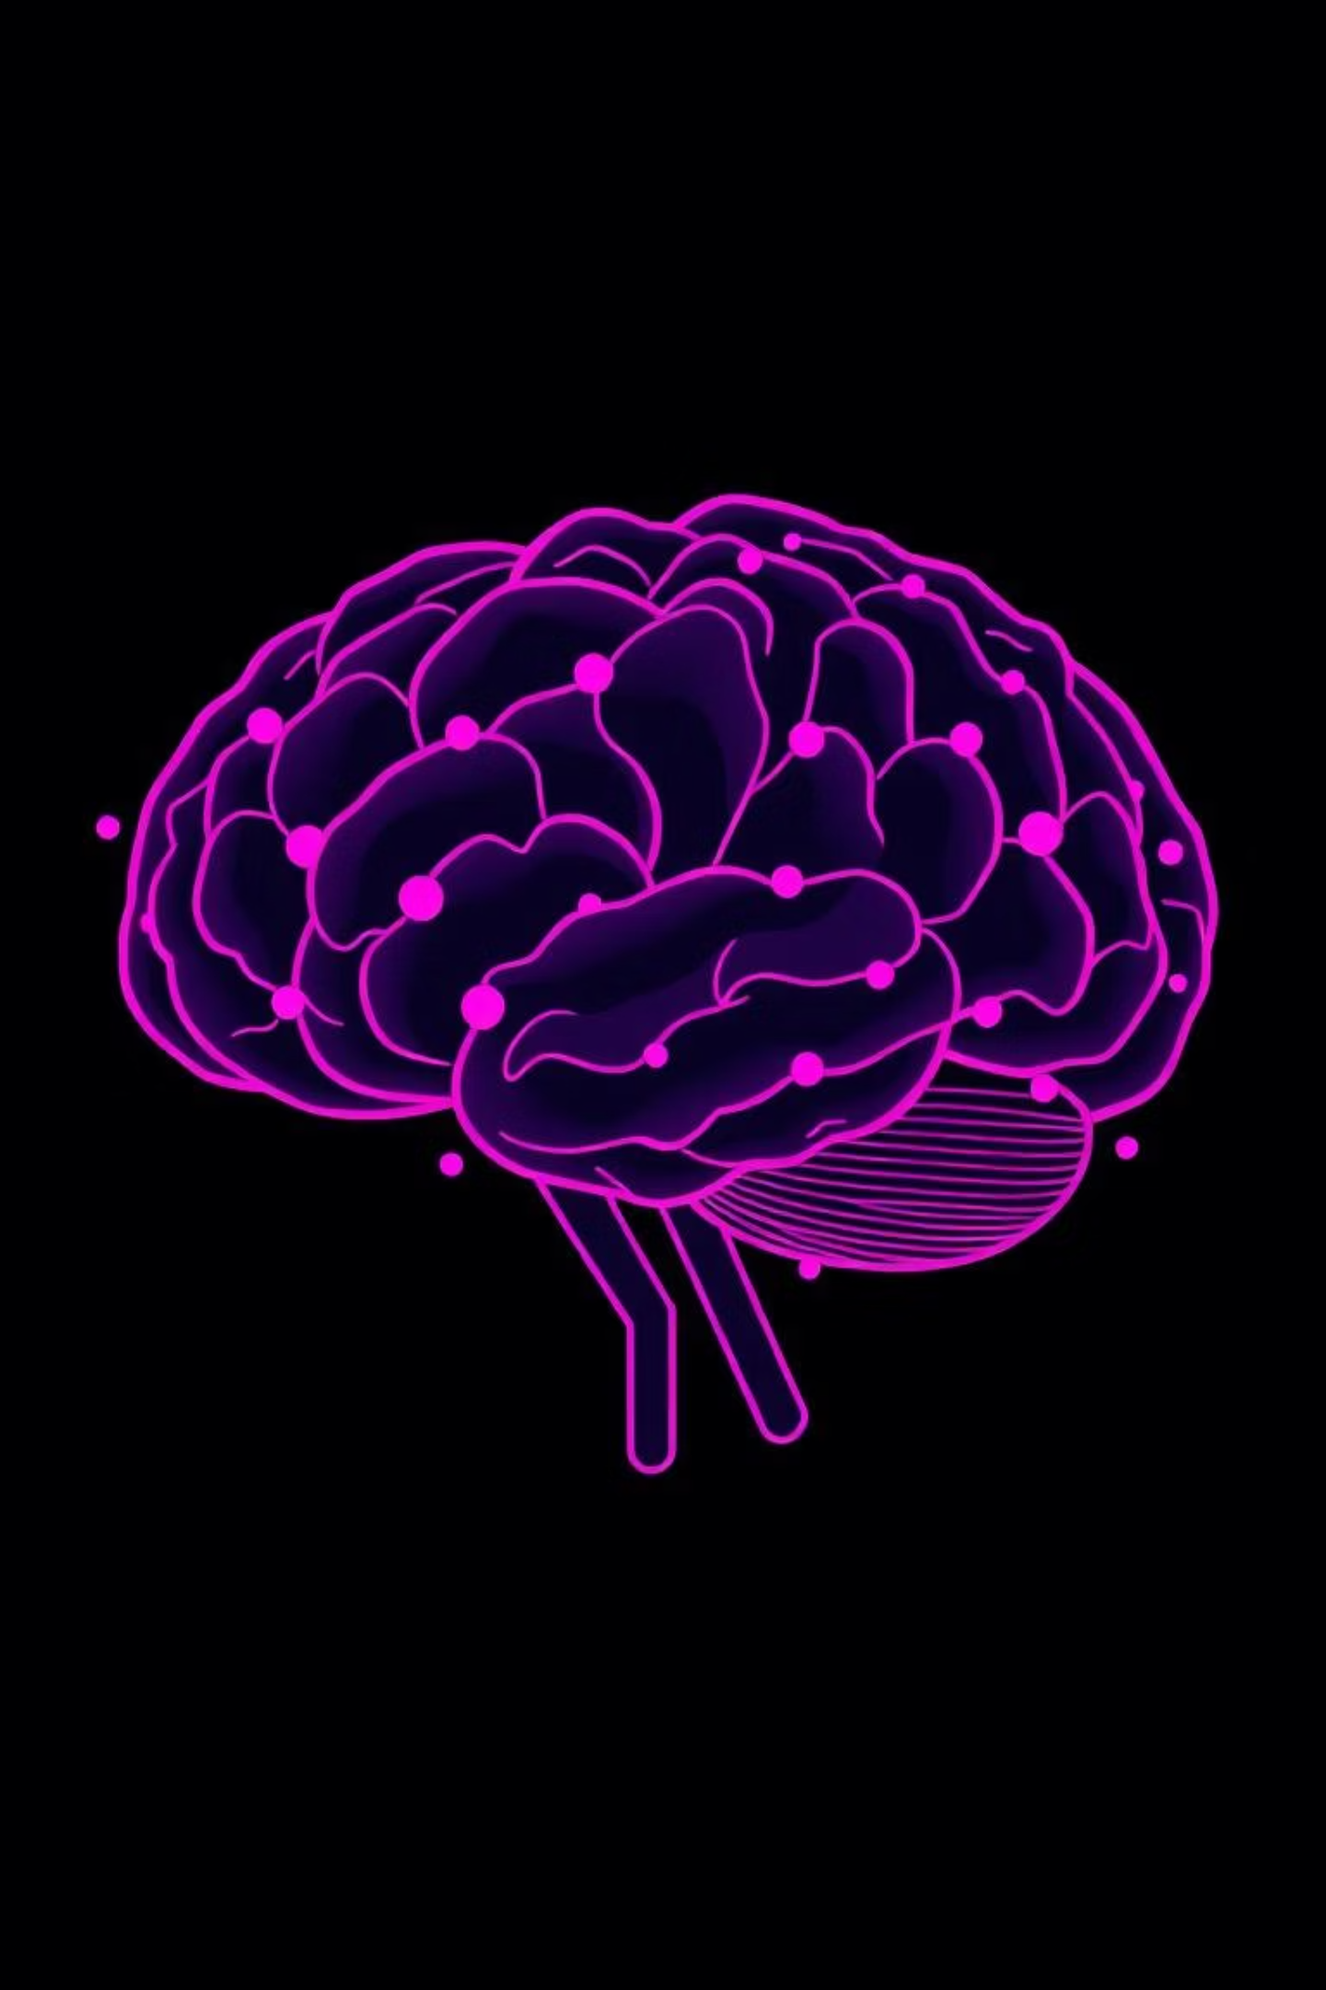
Fundamentals of Artificial Intelligence
Understanding the core concepts that power intelligent systems — from human cognition to machine reasoning.

Slide 2

Intelligence: Human and Beyond
The Human Mind
Non-Human Intelligence
Our brains process sensory information, learn from experience, solve complex problems, and adapt to new situations. This remarkable ability to reason, plan, and understand defines human intelligence.
Animals exhibit problem-solving and adaptive behaviors. Artificial Intelligence mimics these cognitive abilities through computational methods, enabling machines to perceive, reason, and act in the world.
Connection: AI aims to replicate the mental processes of intelligence—whether through symbolic reasoning or neural network patterns inspired by biological brains.

Slide 3

Four Perspectives on AI
Thinking Humanly
Modeling how the human mind solves problems
Acting Humanly
Turing test: Can machines behave indistinguishably from humans?
Thinking Rationally
Using logic and formal reasoning to reach conclusions
Acting Rationally
Taking optimal actions given available information and goals

Slide 4


Intelligent Agents: The Foundation
An agent is any system that perceives its environment and acts to achieve specific goals.
01
02
03
Perception
Reasoning
Action
Agent gathers information through sensors about its environment
Agent processes information and decides on appropriate actions
Agent executes decisions that affect its environment

Slide 5
Five Types of Intelligent Agents
Simple Reflex Agent
Model-Based Reflex Agent
Goal-Based Agent
Responds immediately to current percepts without memory — like a thermostat responding to temperature.
Maintains internal state to track environment changes, enabling responses to complex situations.
Pursues specific objectives and plans sequences of actions to achieve desired goals.
Utility-Based Agent
Learning Agent
Optimizes outcomes using a preference measure, maximizing satisfaction across multiple objectives.
Improves performance over time through experience, adapting its behavior based on feedback.

Slide 6

Approaches to AI
Symbolic AI
Evolutionary AI
Uses explicit rules and logic. Agents reason through structured knowledge representation — think chess engines with rule-based strategies.
Mimics natural selection, evolving solutions through mutation and selection — useful for optimization problems.
Statistical/ML
Connectionist AI
Learns from data using probability and statistics, discovering patterns without explicit programming.
Inspired by neural networks, learning patterns from data. Powers modern deep learning and image recognition.

Slide 7






Understanding AI Environments
An agent's environment has characteristics that determine how it must reason and act.
Deterministic vs. Stochastic
Observable
Deterministic: Actions always have same outcome. Stochastic: Uncertain outcomes.
Fully: Agent sees entire state. Partially: Agent has incomplete information.
Static vs. Dynamic
Static: Environment unchanging. Dynamic: Environment changes while agent deliberates.
Single vs. Multi-Agent
Discrete vs. Continuous
Single: One agent. Multi: Multiple agents interact and compete or cooperate.
Discrete: Finite states and actions. Continuous: Infinite possibilities (e.g., robot motion).

Slide 8
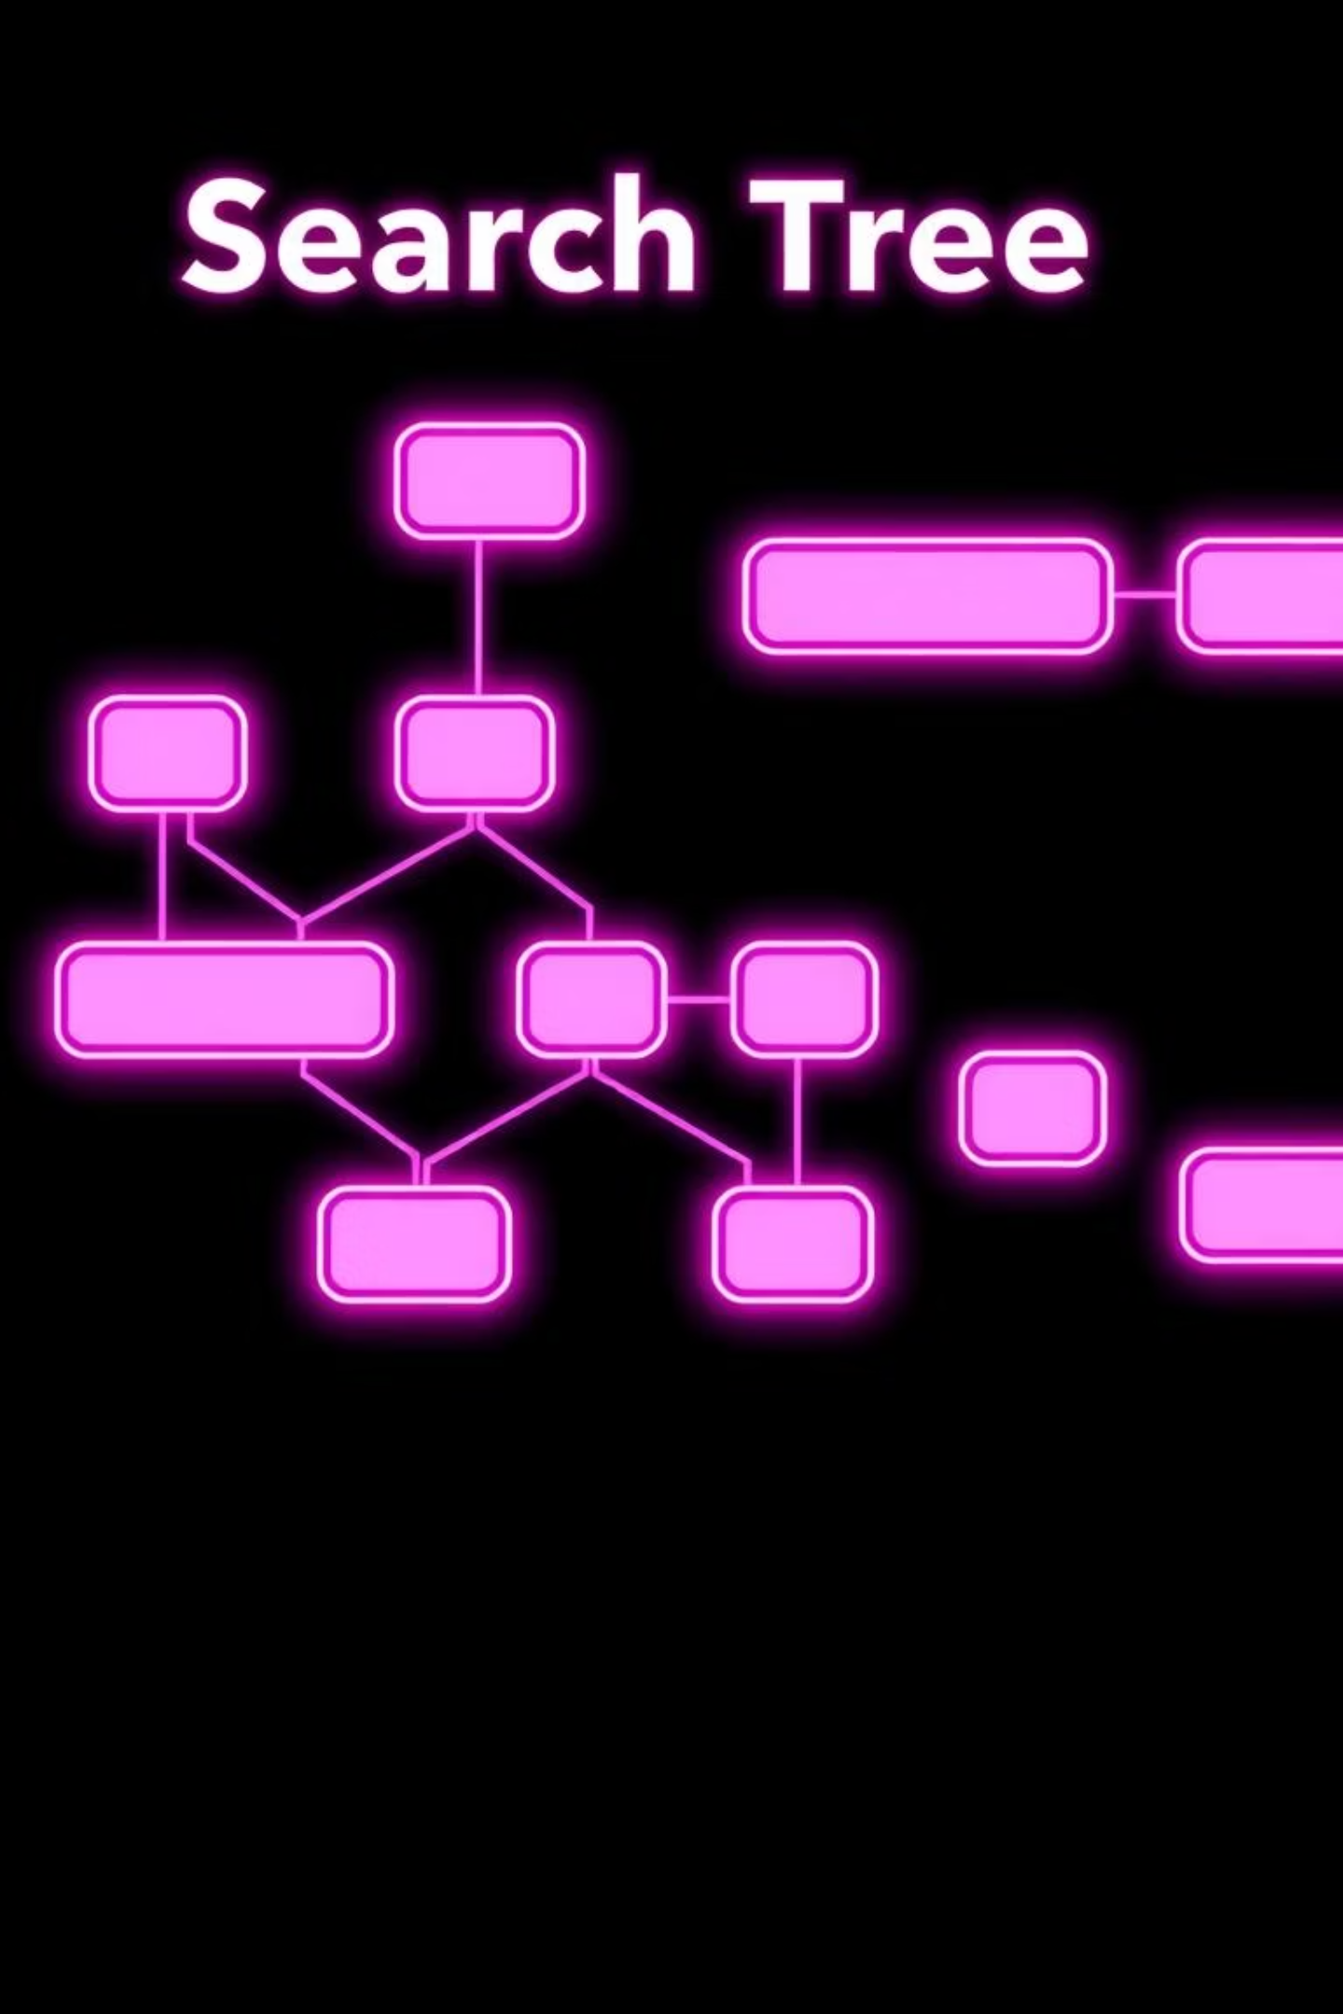
Search and Problem Solving
State Space Representation: Problems are solved by exploring possible states from initial state to goal state. A search tree maps the space of possible solutions.
1
Uninformed Search
BFS and DFS explore without problem knowledge. DLS limits depth; IDS combines depth-first with iterative deepening.
2
Bidirectional Search
Searches simultaneously from start and goal, meeting in the middle — reducing search space significantly.
3
Heuristics Matter
Using domain knowledge (Manhattan Distance, Misplaced Tiles) guides search toward goals efficiently rather than blind exploration.

Slide 9

Informed Search and Optimization
Informed Search Algorithms
Optimization Techniques
Hill Climbing: Follows steepest improvement, fast but risks local optima
Best-First Search: Greedily selects most promising nodes
A* Algorithm: Combines actual cost with heuristic estimate — optimal and complete
Minimax: Game search exploring all moves to find best strategy
AO* Algorithm: Handles AND-OR graph problems with multiple solution paths
Alpha-Beta Pruning: Eliminates branches that won't affect final choice

Slide 10
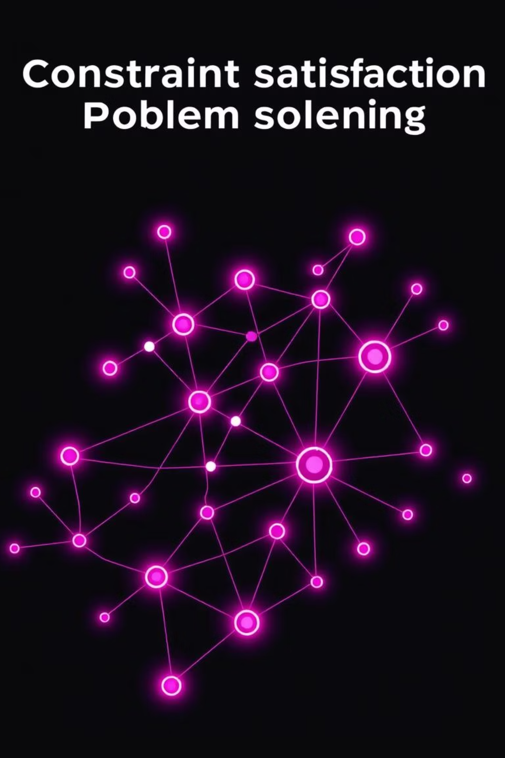



Mastering Constraints and Problems
Problem Definition
Initial state, actions, transition model, goal test, path cost form a well-defined problem
Constraint Satisfaction
CSPs like Sudoku use constraint propagation and backtracking to find valid solutions
Intelligent Problem-Solving
Agents combine perception, reasoning, search, and optimization to navigate complex environments effectively
🎯 Key Insight: Classical AI foundations remain essential. From state-space search to heuristic optimization, these concepts power modern intelligent systems that learn, reason, and solve real-world problems.

